Slide 1
Machine Learning in Business John C. Hull
Chapter 10
Applications in Finance

Slide 2
Call and Put Options
Call option is an option to buy an asset on a certain future date (the maturity) for a certain price (the strike price)
Put option is an option to sell an asset on a certain future date (the maturity) for a certain price (the strike price)

Slide 3
The Payoffs
Call Option
Put Option

Slide 4
Importance of volatility
The asymmetry in the payoff means that volatility, σ, is important in determining option prices
As volatility increases, the price of a call or put option increases

Slide 5
Moneyness
Moneyness is a measure of the extent to which an option is likely to be exercised
Popular definitions (S = asset price, K = strike price)
At-the money: S = K
In-the money: S > K for call options and S < K for put options
Out-of-the-money: S < K for call options and S > K for put options

Slide 6
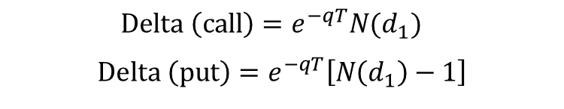
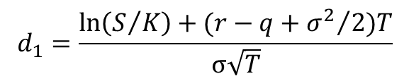
Delta
The delta of a portfolio is the sensitivity of the portfolio to the underlying asset price
A delta-neutral portfolio is not sensitive to small changes in the underlying asset price
If
$$d_{1}=\frac{\ln\left(S/K\right)+(r−q+{σ^{2}}/2)T}{σ\sqrt{T}}$$
$$Delta \left(call\right)=e^{−qT}N(d_{1})$$
$$Delta \left(put\right)=e^{−qT}\left[N\left(d_{1}\right)−1\right]$$
where Τ is time to maturity, r is risk-free rate, and q is dividend yield

Slide 7
Delta continued
Call Option
Put Option

Slide 8
Delta continued
Traders can make themselves delta-neutral by trading the underlying asset
They also use delta as a measure of moneyness for call and put options
Call is at-the-money when delta =0.5
Call is in-the-money when delta > 0.5
Call is out-of-the-money when delta < 0.5
Put is at-the-money when delta = –0.5
Put is in-the-money when delta < –0.5
Put is out-of-the-money when delta > –0.5

Slide 9
Implied volatilities
The Black-Scholes-Merton price of an option depends on S, K, r, q, σ, and T
S, K, r, and T are known for an option
q can be estimated from futures or forward contracts
This means that σ is the only unknown.
There is a one-to-one correspondence between option price and σ
The implied volatility of an option is the volatility that when substituted into Black-Scholes-Merton formula gives the price of the option in the market

Slide 10
Implied volatilities continued
If Black-Scholes-Merton was used for pricing, all options on an asset would have the same implied volatility
In fact, there is quite a variation in implied volatilities
Nevertheless implied volatilities are used to communicate prices and it is therefore important for traders to monitor implied volatilities
The volatility surface shows implied volatilities as a function of
Moneyness (measured by delta)
Time to maturity, T

Slide 11
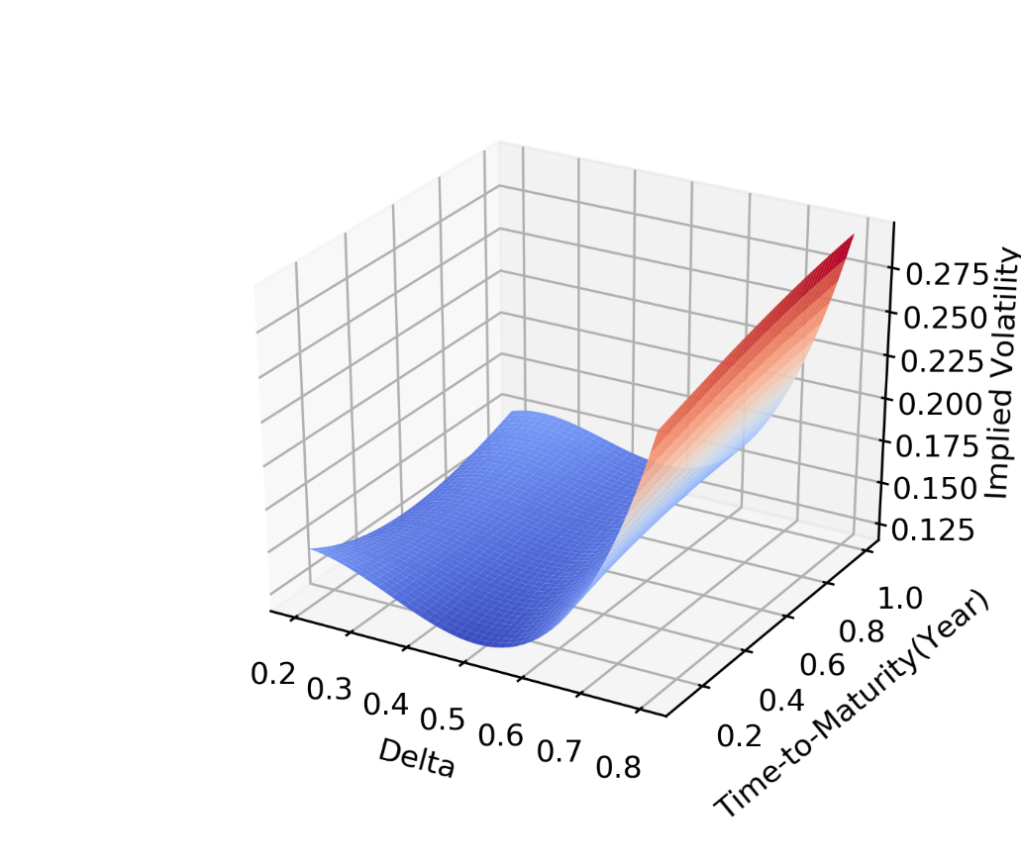
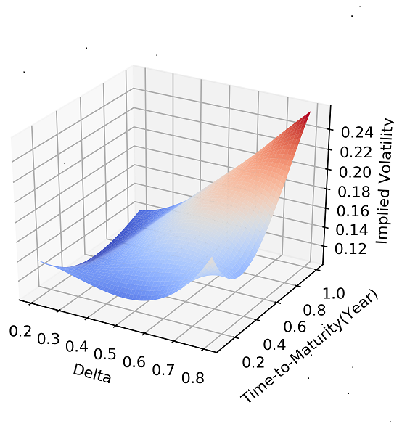
Volatility Surfaces for S&P 500
Jan 31, 2019
June 25, 2019

Slide 12
Volatility Surface Movements
When the price of the underlying asset increases (decreases), implied volatilities tend to decrease (increase)
However not all implied volatilities change by the same amount
This explains the variation in volatility surfaces

Slide 13
Understanding Volatility Surface Movements
To understand volatility surface movements we used data on S&P 500 call options to construct a neural network
Input layer:
Daily asset price return
Moneyness (measured by delta)
Time to maturity
Output layer:
Change in implied volatility

Slide 14
Details
3 hidden layers
20 neurons per layer
Observations from 2014-2019
Randomly sampled 100 options per day
125,700 options in total
60% for training set
20% for validation set
20% for test set
Z-score scaling

Slide 15
Sample of raw data
After scaling:

Slide 16
Mean Squared Error (Training stopped after 5,826 epochs)

Slide 17
Results
Test set were a modest 14% improvement over a simple analytic model proposed by Hull and White in 2017
However, when the VIX index on Day t was used as a feature to predict changes between Day t and Day t+1 there was a considerable improvement
The behavior of the volatility surface is different in high and low volatility environments

Slide 18
Second Application: Hedging
Suppose we do not know how to calculate delta
Can reinforcement hedging find a good hedging strategy?

Slide 19
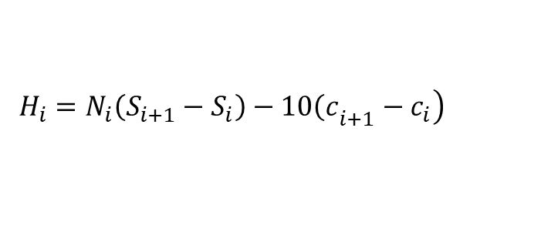
The set up
We generated 3 million stock price paths for training using the process assumed by Black-Scholes-Merton
We assumed that a trader wishes to hedge a short position in 10 call options
The options last 10 days
Probability of exploration starts at 1 and has a decay factor of 0.999999
Each day the trader can change her position so that 0, 1, 2,…, or 10 shares are held
Hedging cost on day i is
where N_{i} is the number of shares held, S_{i} is the share price at the beginning of Day i and c_{i} is the BSM call option price at the beginning of Day i
$$\left.H_{i}=N_{i}\left(S_{i+1}−S_{i}\right)−10{\left(c\right.}_{i+1}−c_{i}\right)$$

Slide 20
Test Set Results
The objective was to minimize the variance of total hedging costs
Our results were close to those given by delta hedging
The mean absolute difference between positions taken by the algorithm and those that would be taken with delta hedging when averaged across all hedging days was 0.33

Slide 21
Extensions
Results can be extended to the situation where there are transactions costs (non-negligible bid-offer spreads) so that (a) delta hedging is not optimal and (b) the problem is a genuine multi-period one
It is then necessary to trade off the mean cost of hedging with the variance of the cost of hedging
A similar approach can be used to hedge volatility where transaction costs are high
A mixture of processes can be used when the hedger is uncertain about the true process. (This is a device to ensure that the hedging strategy works reasonably well for all processes.)

Slide 22
Other Finance Applications
Investing
Private equity
Hiring decisions
Lending
Identifying fraud
Order execution
Collateral management
Fast derivative valuation

